Slide 1

Work Report
Kē Lìhuī (柯力輝)
(Shivam Kharangate)
6/29/2024

Slide 2
Progress on ResLSTM
ResLSTM architecture was studied (research paper and existing code), updated the code from old imports and code syntaxes format. (result in working code)
Improved model results with experimenting and replacing and adding new layers in the main model. (some new layers were added and also replaced, but result was not improved) (Batch -> Group & Layer, LSTM -> GRU & Bidirectional)
Replaced Max with Average in Pooling layer, and also replaced Relu activation layer with LeakyReLU activation layers. (tried softmax & sigmoid, didn’t improve)
Created a function to replace Flatten layer, included with a reshape, global average and max pooling, and also dropout layers. (didn’t improve result)

Slide 3
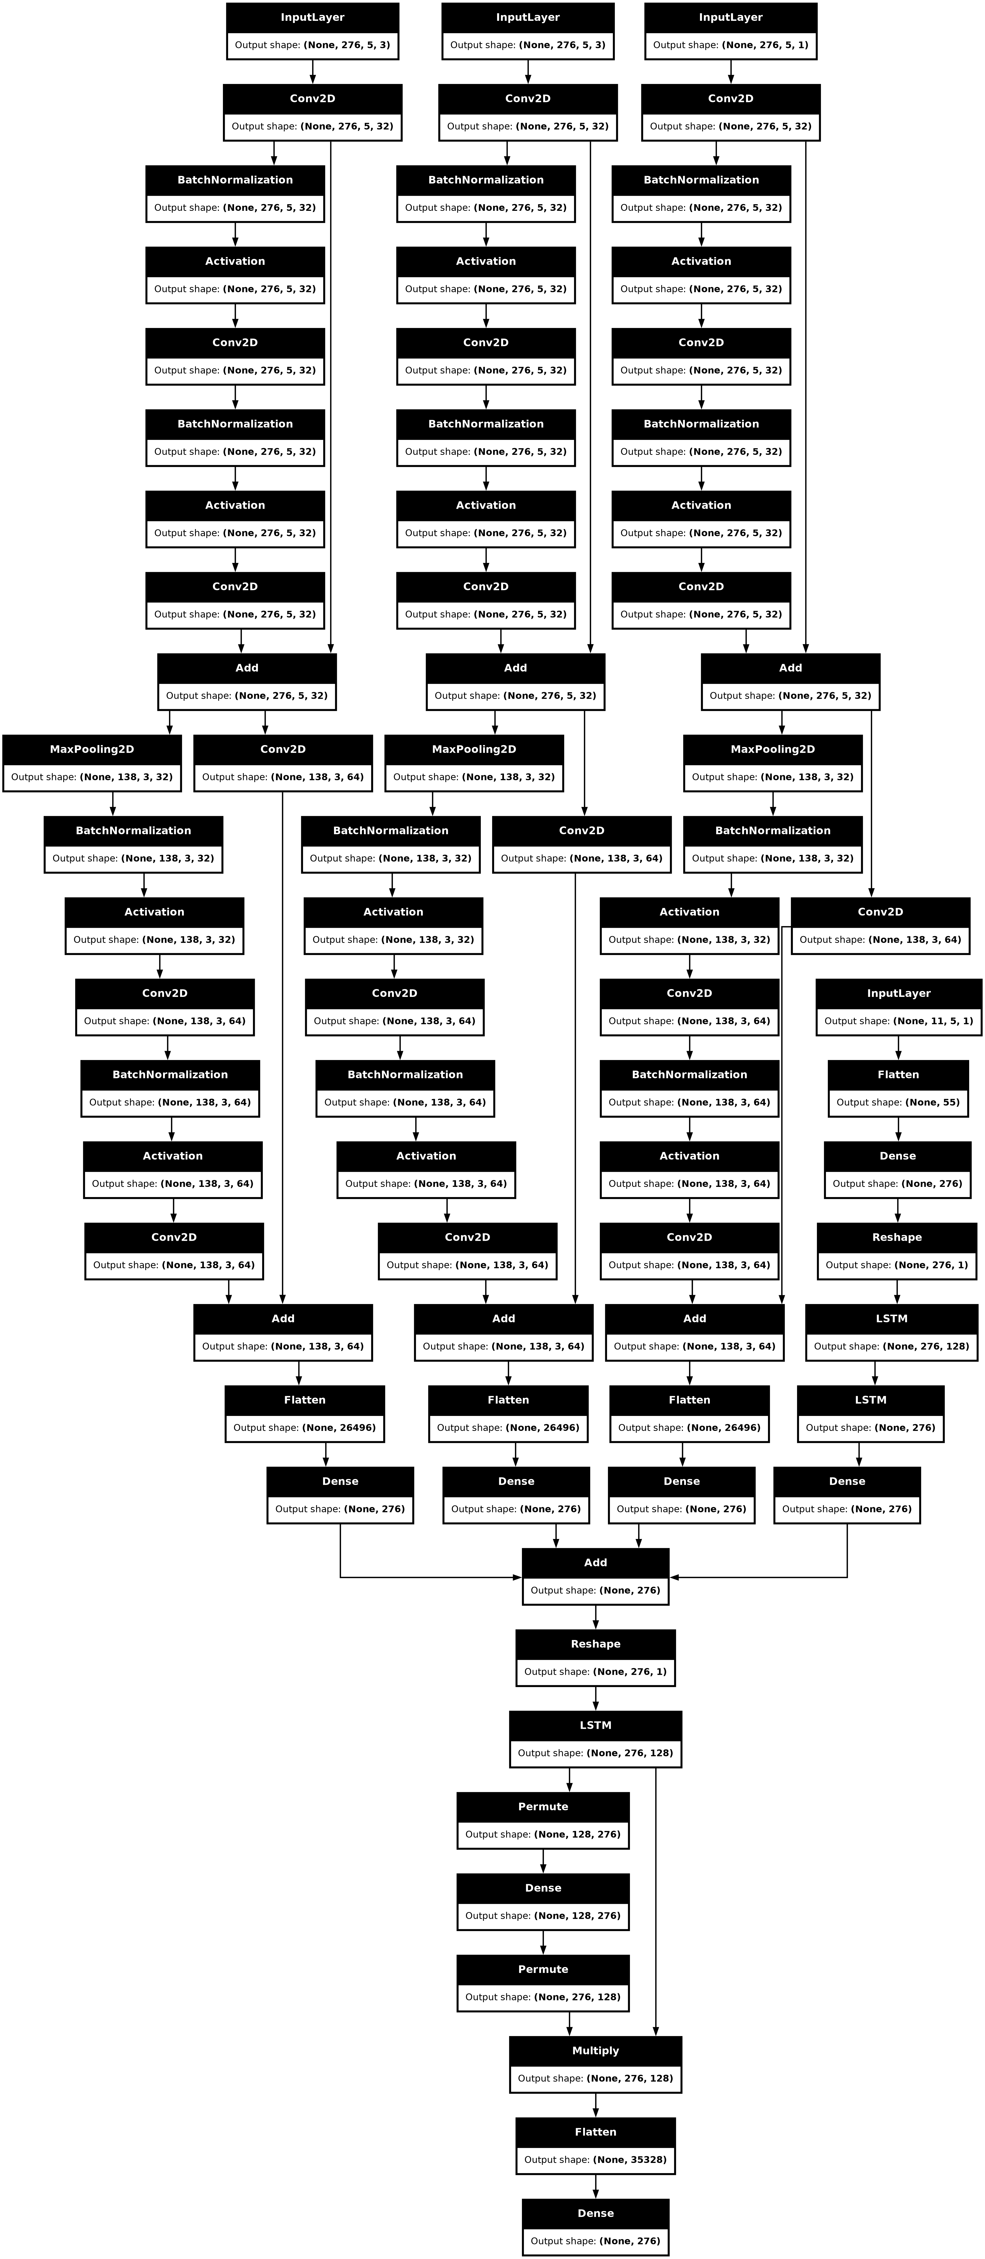
ResLSTM Model Output

Slide 4
Progress on ConvGCN
ConvGCN architecture was studied (research paper and existing code), updated the code from deprecated imports and code syntaxes format. (result in working executable code)
Tested model results with experimenting and replacing and adding new layers in the main model, replaced Relu activation layer with LeakyReLU activation layers (some new layers were added and also replaced, but result was not improved)
The main custom GCN layer was experimented on, modifying the implementation, and also used different types of GCNs, but no improvement.
Some analysis was done using regression models (Linear, Ridge, Random Forest) to understand the deviation and predict future RMSE results.
This included training the regression model to give a consistent and accurate result, and mainly to visualize the output data through graphs.

Slide 5
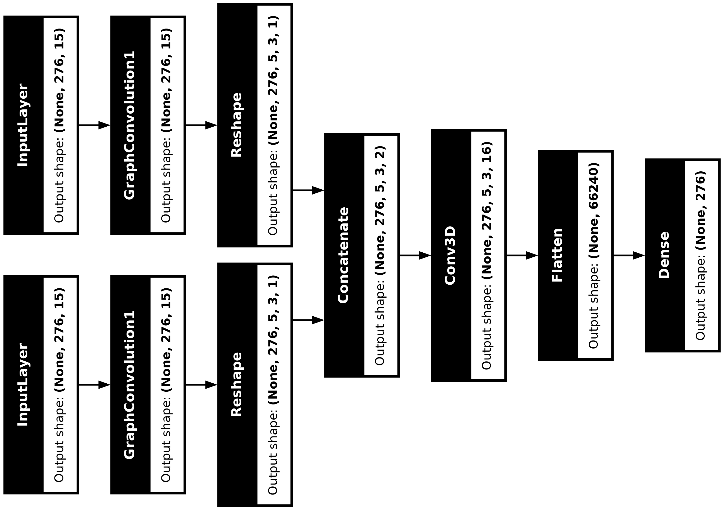
ConvGCN Model Output
Experimented Layers:
For GCN layers, spektral, stellargraph and Graph nets were tested.
BatchNormalization and Dropout layers are added after the Conv3D.

Slide 6
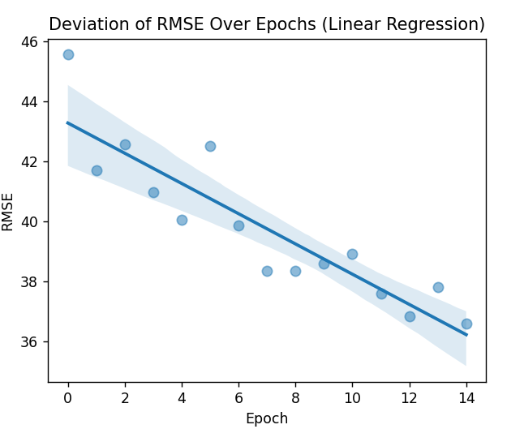
ConvGCN Output Graph
The RMSE values in the graph decrease over 150 epochs. Since the learning rate (Adam 0.001) is set appropriately, the model makes progress in minimizing the RMSE.
L2 regularization layer helps in preventing overfitting, resulting in steady decline in RMSE.

Slide 7
Results of both architectures
Metrics Evaluated | ResLSTM (old) | ResLSTM (updated) | ConvGCN (latest)
RMSE: | 43.814 | 39.349 | 36.572
R2: | 0.945 | 0.955 | 0.967
MAE: | 25.121 | 22.852 | 21.768
WMAPE: | 0.0939 | 0.0854 | 0.0810
Training time in seconds: | 721.809 (12.03 mins) | 759.819 (12.66 mins) | 86.735 (1.44 mins)

